Slide 1
OOP
Lecture # 17
Dynamic Memory Allocation
Linked Lists

Slide 2
Memory Management
A typical memory representation of C program consists of following sections.
Text segment
Initialized data segment
Uninitialized data segment
Stack
Heap

Slide 3
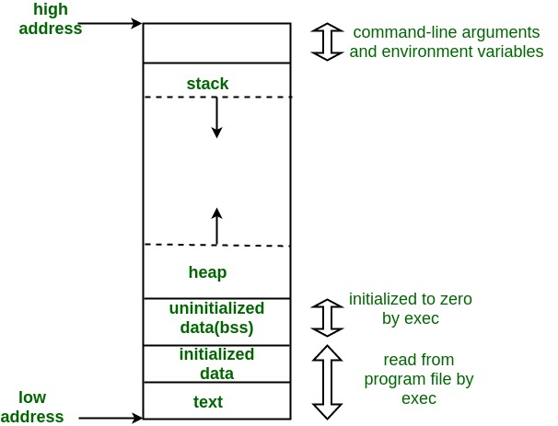

Slide 4
Text Segment
A text segment , also known as a code segment or simply as text.
Sections of a program in an object file or in memory, which contains executable instructions.
As a memory region, a text segment may be placed below the heap or stack in order to prevent heaps and stack overflows from overwriting it.

Slide 5
Usually, the text segment is sharable so that only a single copy needs to be in memory for frequently executed programs, such as text editors, the C compiler, the shells, and so on.
Also, the text segment is often read-only, to prevent a program from accidentally modifying its instructions.

Slide 6
Initialized Data Segment
Initialized data segment, usually called simply the Data Segment.
A data segment is a portion of virtual address space of a program.
Contains the global variables and static variables that are initialized by the programmer.
Note that, data segment is not read-only, since the values of the variables can be altered at run time.

Slide 7
This segment can be further classified into initialized read-only area and initialized read-write area.
For instance the global string defined by char s[] = “hello world” in C and a C statement like int debug=1 outside the main (i.e. global) would be stored in initialized read-write area.
And a global C statement like const char* string = “hello world”
makes the string literal “hello world” to be stored in initialized read-only area
the character pointer variable string in initialized read-write area.
Ex: static int i = 10 will be stored in data segment and global int i = 10 will also be stored in data segment

Slide 8
Uninitialized Data Segment
Uninitialized data segment, often called the “bss” segment, named after an ancient assembler operator that stood for “block started by symbol.”
Data in this segment is initialized by the kernel to arithmetic 0 before the program starts executing
Uninitialized data starts at the end of the data segment and contains all global variables and static variables that are initialized to zero or do not have explicit initialization in source code.
For instance a variable declared static int i; would be contained in the BSS segment. For instance a global variable declared int j; would be contained in the BSS segment.

Slide 9
Stack
The stack area traditionally adjoined the heap area and grew the opposite direction;
when the stack pointer met the heap pointer, free memory was exhausted.
(With modern large address spaces and virtual memory techniques they may be placed almost anywhere, but they still typically grow opposite directions.)

Slide 10
The stack area contains the program stack, a LIFO structure, typically located in the higher parts of memory.
On the standard PC x86 computer architecture it grows toward address zero; on some other architectures it grows the opposite direction.
A “stack pointer” register tracks the top of the stack; it is adjusted each time a value is “pushed” onto the stack.
The set of values pushed for one function call is termed a “stack frame”; A stack frame consists at minimum of a return address.
Notes:
LIFO= Last In First Out

Slide 11
Return Address
Return value
Local variables
Arguments

Slide 12
Stack, where automatic variables are stored, along with information that is saved each time a function is called.
Each time a function is called, the address of where to return to and certain information about the caller’s environment, such as some of the machine registers, are saved on the stack.
The newly called function then allocates room on the stack for its automatic and temporary variables.
This is how recursive functions in C can work.
Each time a recursive function calls itself, a new stack frame is used, so one set of variables doesn’t interfere with the variables from another instance of the function.

Slide 13
Heap
Heap is the segment where dynamic memory allocation usually takes place.
The heap area begins at the end of the BSS segment and grows to larger addresses from there.
The Heap area is managed by malloc(), realloc(), new, delete and free.
Which may use the brk and sbrk system calls to adjust its size (note that the use of brk/sbrk and a single “heap area” is not required to fulfill the contract of malloc/realloc/free; they may also be implemented using mmap to reserve potentially non-contiguous regions of virtual memory into the process’ virtual address space).
The Heap area is shared by all shared libraries and dynamically loaded modules in a process.

Slide 14
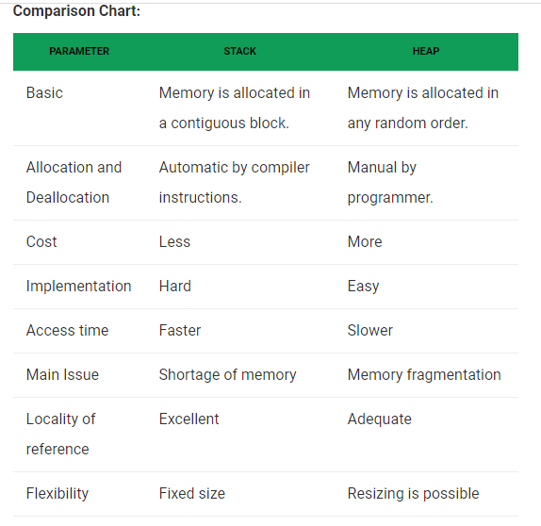

Slide 15
Differences B/W Heap & Stack
In a stack, the allocation and deallocation is automatically done by whereas, in heap, it needs to be done by the programmer manually.
Handling of Heap frame is costlier than handling of stack frame.
Memory shortage problem is more likely to happen in stack whereas the main issue in heap memory is fragmentation.
Stack frame access is easier than the heap frame as the stack have small region of memory and is cache friendly, but in case of heap frames which are dispersed throughout the memory so it cause more cache misses.
Stack is not flexible, the memory size allotted cannot be changed whereas a heap is flexible, and the allotted memory can be altered.
Accessing time of heap takes is more than a stack.

Slide 16
Dynamic Memory Allocation
Dynamic memory allocation in C/C++ refers to performing memory allocation manually by programmer.
Dynamically allocated memory is allocated on Heap
Non-static and local variables get memory allocated on Stack.

Slide 17
Applications of Dynamic Memory Allocation
One use of dynamically allocated memory is to allocate memory of variable size which is not possible with compiler allocated memory except variable length arrays.
The most important use is flexibility provided to programmers. We are free to allocate and deallocate memory whenever we need and whenever we don’t need anymore. There are many cases where this flexibility helps. Examples of such cases are Linked List, Tree, etc.

Slide 18
C uses malloc(), realloc() and calloc() function to allocate memory dynamically at run time and uses free() function to free dynamically allocated memory.
C++ supports these functions and also has two operators new and delete that perform the task of allocating and freeing the memory in a better and easier way.

Slide 19
new operator
The new operator denotes a request for memory allocation on the Heap.
If sufficient memory is available, new operator initializes the memory and returns the address of the newly allocated and initialized memory to the pointer variable.
Syntax: pointer-variable = new data-type;

Slide 20
Example
// Pointer initialized with NULL. Then request memory for the variable
int *p = NULL;
p = new int;
OR
// Combine declaration of pointer and their assignment
int *p = new int;

Slide 21
Initialize a memory
pointer-variable = new data-type(value);
Example:
int *p = new int(25);
float *q = new float(75.25);

Slide 22
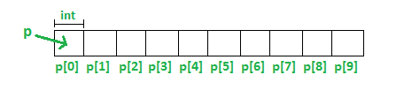
Allocate a block of memory
pointer-variable = new data-type[size];
Example:
int *p = new int[10]

Slide 23
What if enough memory is not available during runtime?
int *p = new(nothrow) int;
if (p==NULL)
{
cout << "Memory allocation failed\n";
}
Notes:
Nothrow with new helps in catching memory issues. If pointer is null it means memory allocation failed so better to check before using it.

Slide 24
delete operator
Since it is programmer’s responsibility to deallocate dynamically allocated memory, programmers are provided delete operator by C++ language.
// Release memory pointed by pointer-variable
delete pointer-variable;

Slide 25
Deallocating block
// Release block of memory pointed by pointer-variable
delete[] pointer-variable;
Example:
// It will free the entire array pointed by p.
delete[] p;

Slide 26
Linked List

Slide 27
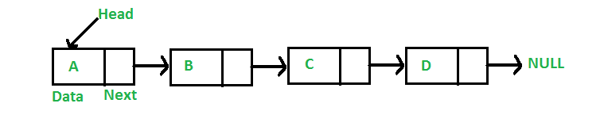
Linked Lists
A linked list is a linear data structure, in which the elements are not stored at contiguous memory locations.
The elements in a linked list are linked using pointers .
In simple words, a linked list consists of nodes where each node contains a data field and a reference(link) to the next node in the list.

Slide 28
Why Linked Lists
Arrays can be used to store linear data of similar types, but arrays have the following limitations. 1) The size of the arrays is fixed: So we must know the upper limit on the number of elements in advance. Also, generally, the allocated memory is equal to the upper limit irrespective of the usage.
2) Inserting a new element in an array of elements is expensive because the room has to be created for the new elements and to create room existing elements have to be shifted.

Slide 29
Advantages over arrays
Dynamic size
Ease of insertion/deletion

Slide 30
Drawbacks
Random access is not allowed. We have to access elements sequentially starting from the first node. So we cannot do binary search with linked lists efficiently with its default implementation.
Extra memory space for a pointer is required with each element of the list.
Not cache friendly. Since array elements are contiguous locations, there is locality of reference which is not there in case of linked lists.

Slide 31
Representation
A linked list is represented by a pointer to the first node of the linked list.
The first node is called the head.
If the linked list is empty, then the value of the head is NULL.
Each node in a list consists of at least two parts: 1) data 2) Pointer (Or Reference) to the next node
In C/C++, we can represent a node using structures.
In Java or C#, LinkedList can be represented as a class and a Node as a separate class.
The LinkedList class contains a reference of Node class type.

Slide 32
Using Structure
// A linked list node in C/C++
struct Node {
int data;
struct Node* next;
};

Slide 33
Using Classes
// A linked list node in C++
class Node {
public:
int data;
Node* next;
};

Slide 34
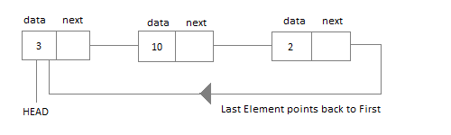
Circular Linked List

Slide 35
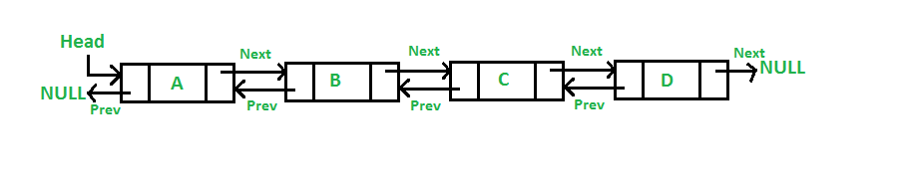
Doubly Linked List

Slide 36
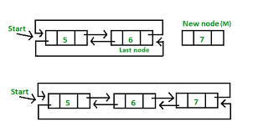
Doubly Circular Linked List

Slide 37
References
https://www.geeksforgeeks.org/memory-layout-of-c-program/
https://www.geeksforgeeks.org/new-and-delete-operators-in-cpp-for-dynamic-memory/
https://www.tutorialspoint.com/cplusplus/cpp_dynamic_memory.htm
https://www.geeksforgeeks.org/stack-vs-heap-memory-allocation/

